Slide 1


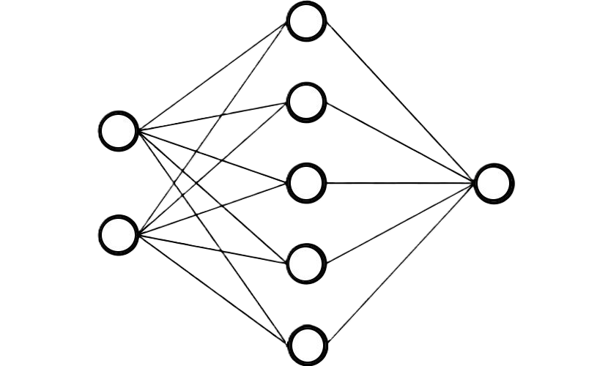
CBDC TokenAI
For Unspent Transaction Output & with Banks side Deployment

Slide 2
Agenda
Introduction
Problem
Solution
Architecture
Workflow
Summary

Slide 3
Introduction
The project develops a Deep Learning time-series prediction model to estimate future UTXO transaction amounts, which are then used to determine the optimal set of token denominations. These predicted tokens are pre-created and stored in the DTSP's MariaDB instance, ensuring that tokens are readily available when an Off-Us transfer request is initiated without facing token selection deadlock.

Slide 4


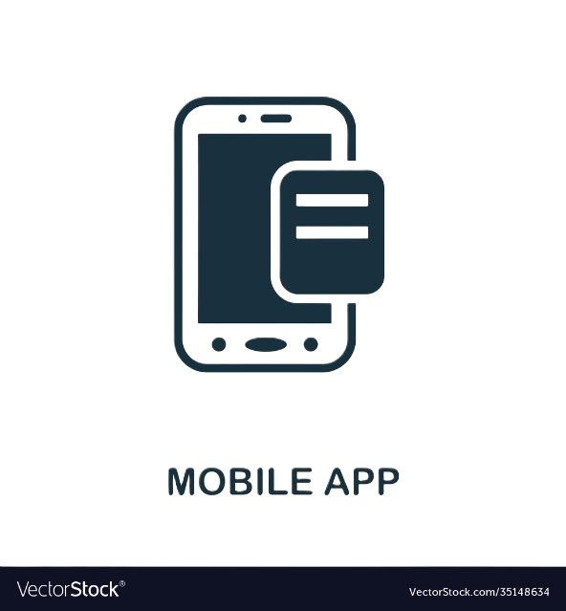
Problem Statement
DLT
Off-Us
Txn
NPCI
Platform
DTSP
DTSP
Bank
PSO
Bank
RTSP
RTSP

Slide 5
Problem Statement
DLT
During Peak Traffic
NPCI
Lag due to Token Splitting
Platform
DTSP
DTSP
Bank
PSO
Bank
RTSP
RTSP

Slide 6
Problem Statement
In an UTXO Off-Us transfer request, the system attempts to select high-value tokens from the available pool to satisfy the transaction amount. Once selected, these tokens are marked as LOCKED to prevent concurrent access and ensure atomicity of the transfer. However, this locking mechanism introduces a bottleneck during high-traffic times.
When multiple transactions simultaneously request high-value tokens—especially during peak loads tokens required by one transaction may already be locked by another. As a result, subsequent transactions are forced to wait until the locked tokens are released, leading to a token deadlock. This causes a queue buildup, where transactions are stalled, waiting for token availability.

Slide 7
Solution
DLT
TokenAI
Pre-splits tokens
NPCI
Platform
DTSP
DTSP
TokenAI
TokenAI
Bank
PSO
Bank
RTSP
RTSP

Slide 8
Agentic AI Solution
To address the challenges of token splitting and transfer delays in CBDC UTXO’s Off-Us txns an DL model is employed to predict upcoming transaction values using historical transaction data. This model leverages temporal features to forecast the expected transactions for future transfers this is done bank-wise at every bank.
Based on these predictions, the system splits tokens in advance for better availability. Specifically, when we have high-volume of transactions coming in during peak times, it pre-splits large-value tokens into multiple smaller denominations. These smaller tokens are then stored in the MariaDB and DLT, ensuring they are readily available for future use.

Slide 9



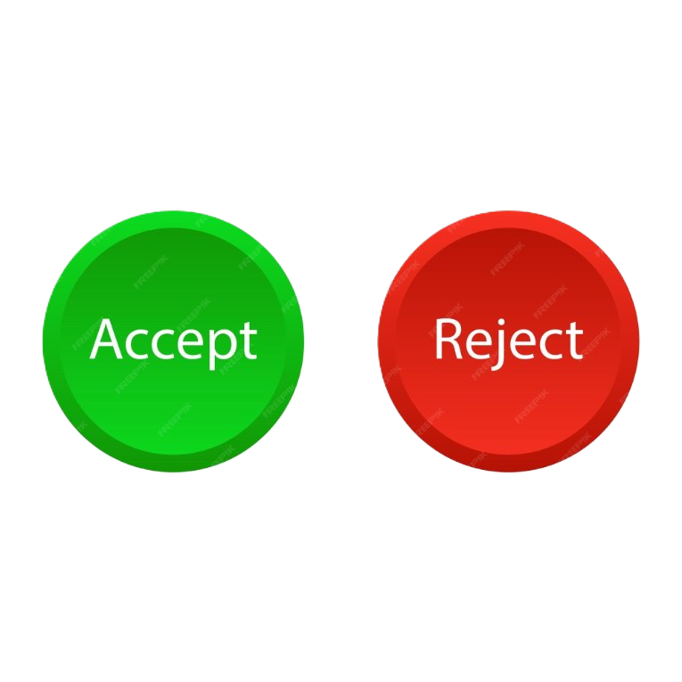







Architecture
UI
CRUD
GET
POST
UTXO
DTSP
API
Server
Transactions
AI AGENT
Token values
ȳ
Processed Token Values
Deployed
Predicted Txns
Http Client
DB
Store
SQLX
Fetch

Slide 10
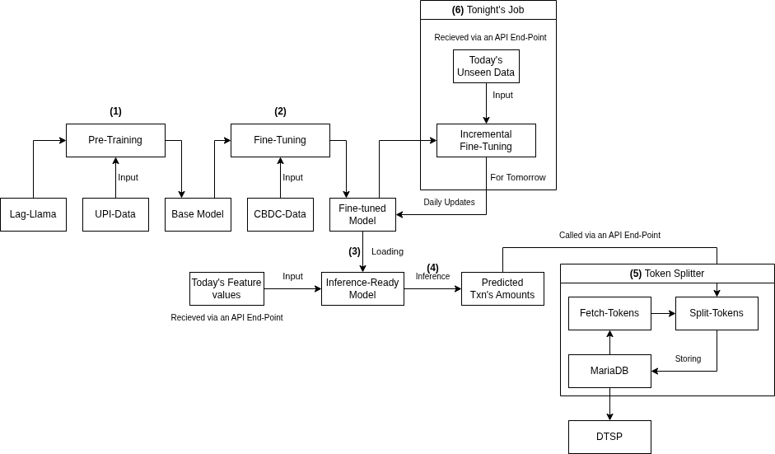





Lag-Llama Inference and Training

Slide 11
Lag-Llama Pre-Training
Initial Training

Slide 12
Lag-Llama Cron Fine-tuning
Daily Training

Slide 13
Lag-Llama Runtime
Inference

Slide 14
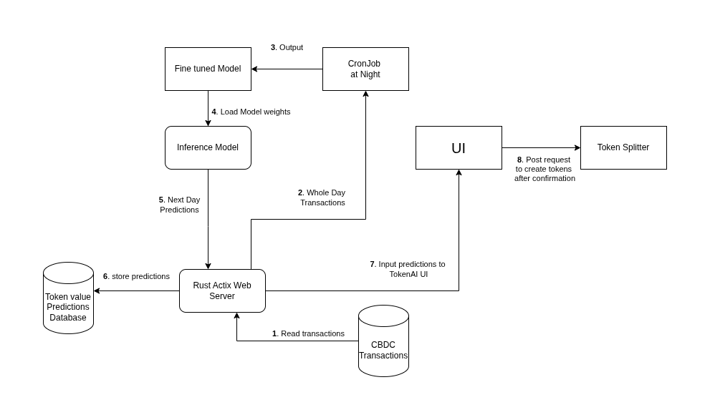
Rust Backend

Slide 15
Post processing of predicted transactions
Challenges
Large number of tokens will lead to MariaDB overhead.
Need to Lock larger amounts of Money for Transactions.
How does post processing solve this?
Round the Predicted Transaction Amount a higher denomination.
Leading to lock smaller amounts of money for each transaction.
Easier to manage token creation.

Slide 16
Post processing rules
if txn.count >= 10:
txn_token = txn.amount
else if txn.amount <= 100:
txn_token = txn.amount
else if txn.amount <= 500 && txn.amount > 100:
txn_token = 500
else if txn.amount <= 1000 && txn.amount > 500:
txn_token = 1000
else if txn.amount > 1000 && txn.amount < 5000:
txn_token = (txn.amount / 1000 + 1) * 1000
else if txn.amount > 5000:
txn_token = 10000

Slide 17
An Example
Amount: ₹130
Frequency: 50
Predicts

Slide 18
An Example
if txn.count >= 10:
txn_token = txn.amount
else if txn.amount <= 100:
txn_token = txn.amount
else if txn.amount <= 500 && txn.amount > 100:
txn_token = 500
else if txn.amount <= 1000 && txn.amount > 500:
txn_token = 1000
else if txn.amount > 1000 && txn.amount < 5000:
txn_token = (txn.amount / 1000 + 1) * 1000
else if txn.amount > 5000:
txn_token = 10000
So, we make
Tokens with
Amount:
₹130
Frequency: 50

Slide 19
Another Example
Amount: ₹25
Frequency: 7
Predicts

Slide 20
Another Example
if txn.count >= 10:
txn_token = txn.amount
else if txn.amount <= 100:
txn_token = txn.amount
else if txn.amount <= 500 && txn.amount > 100:
txn_token = 500
else if txn.amount <= 1000 && txn.amount > 500:
txn_token = 1000
else if txn.amount > 1000 && txn.amount < 5000:
txn_token = (txn.amount / 1000 + 1) * 1000
else if txn.amount > 5000:
txn_token = 10000
So, we make
Tokens with
Amount:
₹25
Frequency: 7

Slide 21
Another Example
Amount: ₹700
Frequency: 3
Predicts

Slide 22
Another Example
if txn.count >= 10:
txn_token = txn.amount
else if txn.amount <= 100:
txn_token = txn.amount
else if txn.amount <= 500 && txn.amount > 100:
txn_token = 500
else if txn.amount <= 1000 && txn.amount > 500:
txn_token = 1000
else if txn.amount > 1000 && txn.amount < 5000:
txn_token = (txn.amount / 1000 + 1) * 1000
else if txn.amount > 5000:
txn_token = 10000
So, we make
Tokens with
Amount:
₹1000
Frequency: 3

Slide 23
Demo
CBDC-TokenAI

Slide 24
Our Team
Jeevan Sammeswar
Praval Pattam
Rajeev Mahato
Subhamoy Sadhukhan
Harshit Rajan
Vijay Ganesh
Balamuragan Veeraswamy

Slide 25
Future Developments
Using Data stored at the Bank instead of TRS
Automatic Token Splitting at Bank side
Token Analytics
Token Merging

Slide 26
Summary
We use Lag-Llama on pre-trained on historical UPI data, fine-tune it on CBDC data for an inference ready model which can predict the upcoming transactions for the next day. These predictions are done bank-wise​
With the help of these predictions, we pre-split the existing tokens at night or during times with low traffic. This enables us to avoid lag in the future.​

Slide 27
Thank You

